Slide 1

Hatchling I BalloonSat
Seth Guberman, Embry-Riddle Aeronautical University

Slide 2
Objective
Embry-Riddle satellite in space by 2013
Hatchling I is one of many steps along the way to having an Embry-Riddle satellite in orbit.
Focus on:
Heritage
Development
Experience
Science
Seth Guberman, ERAU 2010
2

Slide 3
The Mission
Certify components for future missions
Hatchling I uses CubeSat-size electronics to facilitate the transition from balloon payload to satellite.
Pima Community College’s BrightStar is the scientific payload supported by Hatchling I.
Seth Guberman, ERAU 2010
3

Slide 4
The Ride
LSU High-Altitude Student Platform
HASP is a support vehicle providing students with flight opportunity intermediary to small latex sounding balloons and Earth-orbiting satellites.
Profile:
11 million cubic foot balloon
Up to 120,000 foot altitude
Up to 20 hour flight
3 kg student payloads
Seth Guberman, ERAU 2010
4

Slide 5
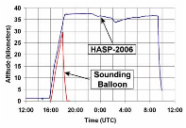
HASP Flight Profile
Long-term exposure to the near-space environment
Figure 1: Flight Profile (Source: laspace.lsu.edu, 2010)
5

Slide 6
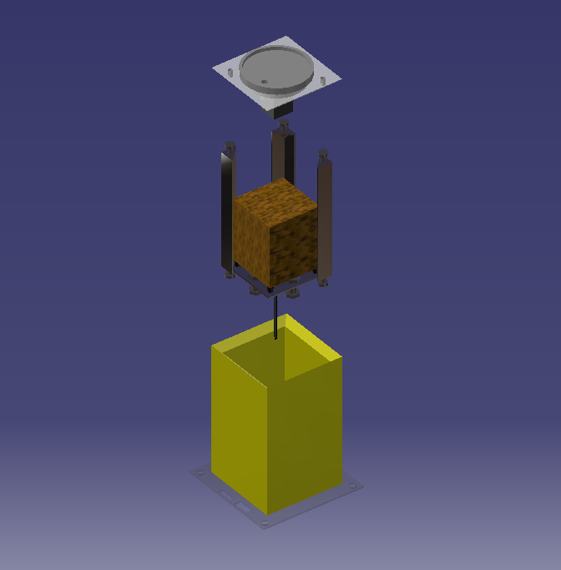
Hatchling I Core Systems
Multipurpose satellite bus
Structure
Power management
On-board computer
Radio communication
PCB Stack
Aluminum Frame
Composite Skin
Figure 2: Exploded View
6

Slide 7
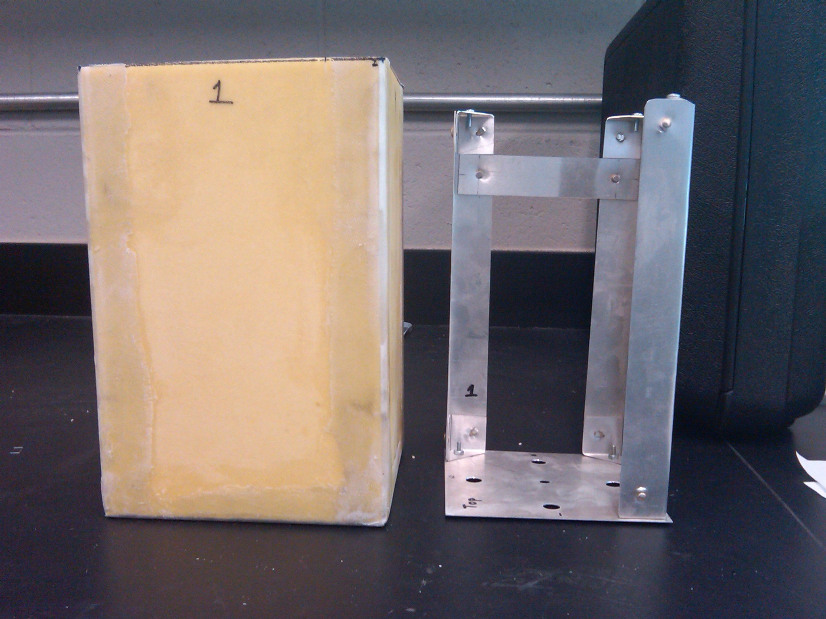
Structure
Foam/E-glass composite with aluminum frame
10.5”
6”
Figure 3: Structure (side view)
7

Slide 8
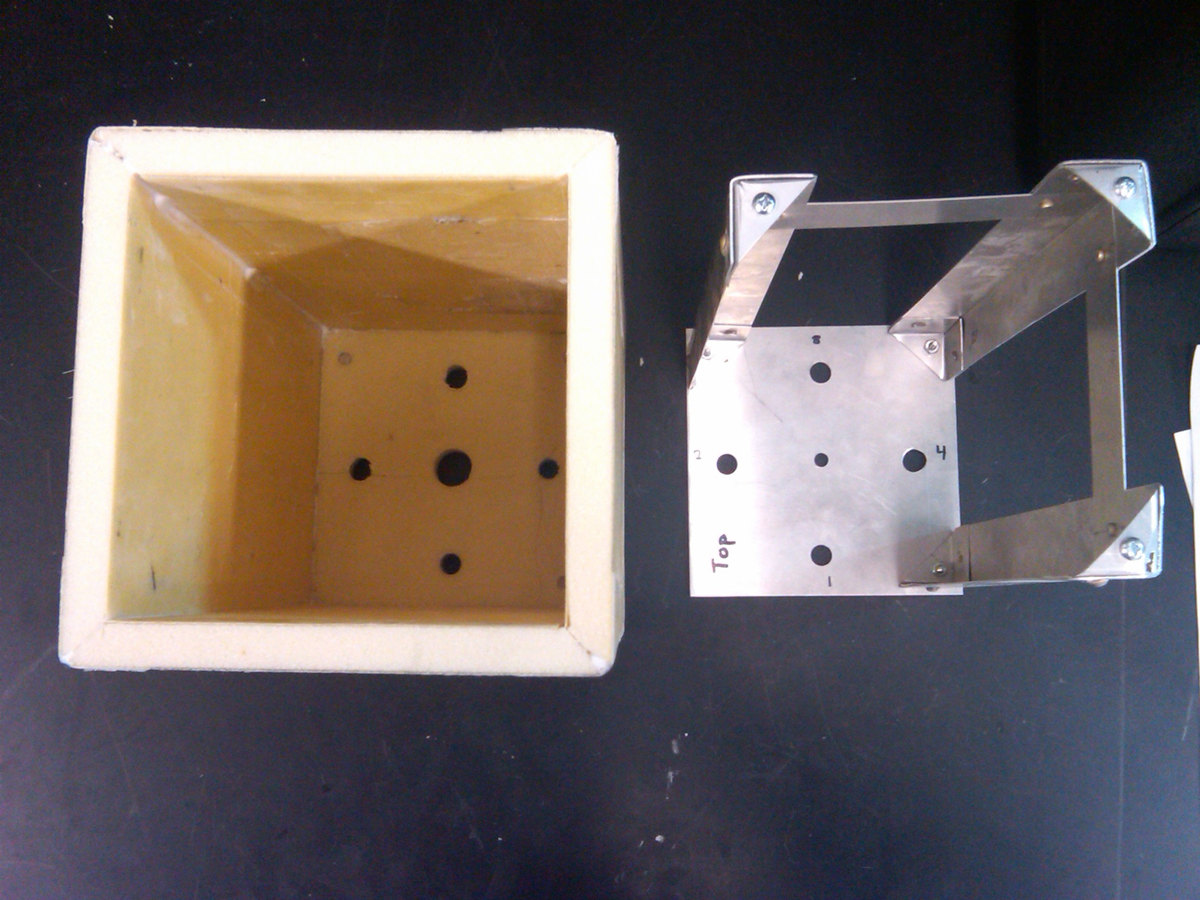
Structure
Foam/E-glass composite with aluminum frame
0.5” thick
Figure 4: Structure (top view)
8

Slide 9
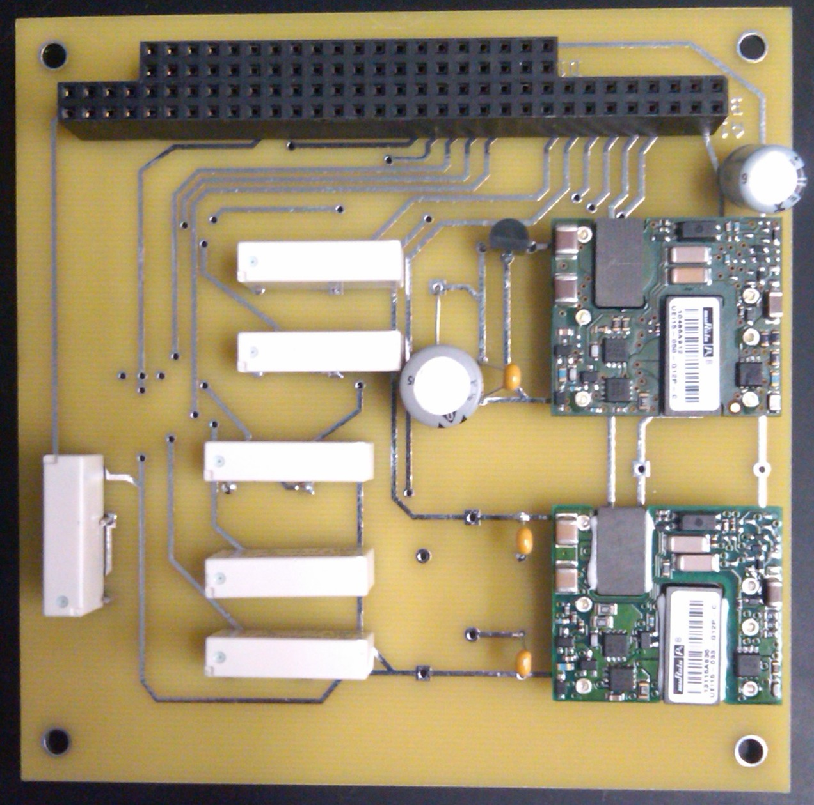
Power Management
Regulate incoming 30V and switch power to components
DC/DC Converters
Relays
Figure 5: Power Management Unit
9

Slide 10
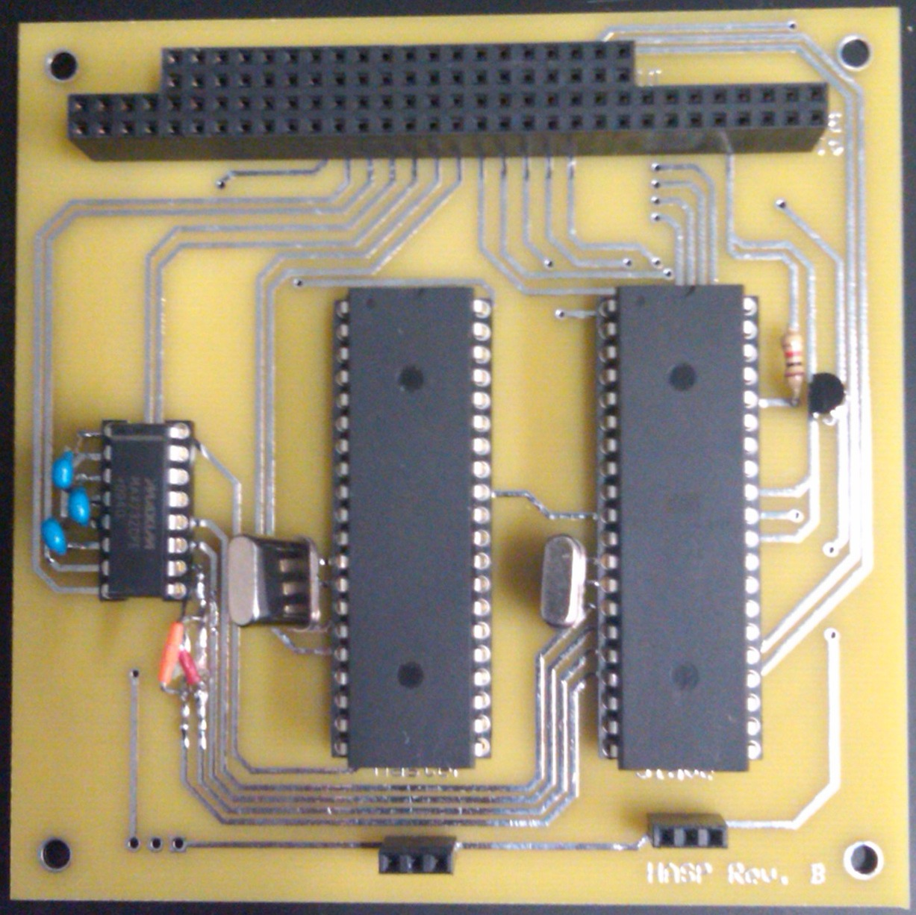
On-board Computer
Package telemetry and relay commands
Dual microprocessors
Level-shifter
Figure 6: On-board Computer
10

Slide 11
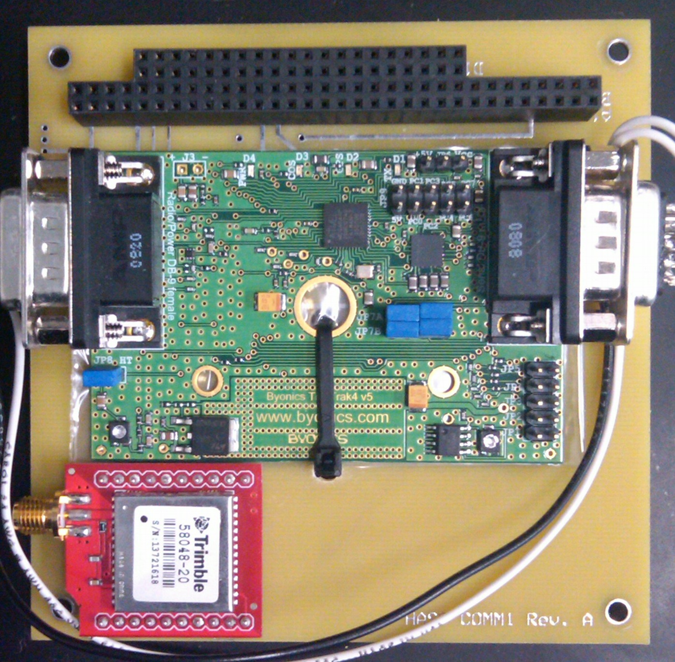
Communication
Package and interpret audio packets
TinyTrak Modem
GPS Receiver
Figure 7: Communication Module
11

Slide 12
Next Steps
To be completed …
Thermal/vacuum test at ERAU
Test flight on ERAU sounding balloon
HASP integration (Summer 2010)
Flight! (September 2010)
Seth Guberman, ERAU 2010
12

Slide 13
Acknowledgements
Thank you to…
Mentor: Jack Crabtree
Mentor: Dr. Ron Madler
Partner: PCC Science Department
Arizona Space Grant Consortium
Seth Guberman, ERAU 2010
13

Slide 14
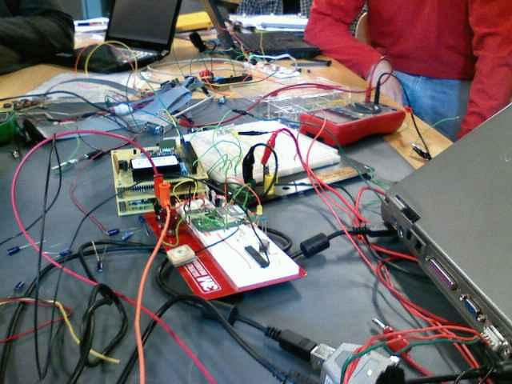
Questions?
“I think there might be a noise problem…”
Figure 8: Data Integration Test with PCC
14

Slide 15
Supplemental Slides
Just in case…

Slide 16


Slide 17
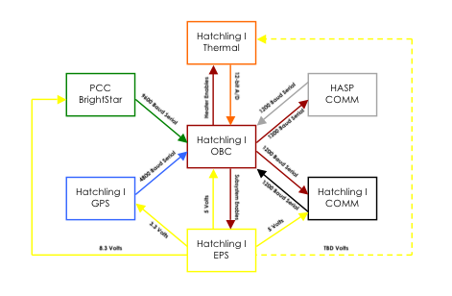

Slide 18
